Slide 1
Assignment 3
IS F462 - Network Programming
Shreyas Bhat
2015A7PS0033G
f20150033@goa.bits-pilani.ac.in

Slide 2
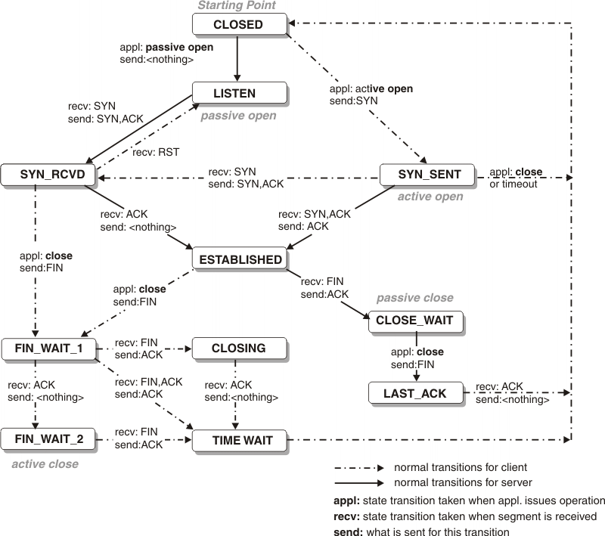
TCP State Diagram
The TCP State Diagram
Reference
https://www.ibm.com/support/knowledgecenter/en/SSLTBW_2.1.0/com.ibm.zos.v2r1.halu101/constatus.htm

Slide 3
TCP Port Numbers and Classes
A total of 65535 TCP ports are available.
TCP port classes :
0–1023 – system or well-known ports (Utilized by services and applications)
1024–49151 – user or registered ports (assigned to user processes and/or applications)
49152-65535 – dynamic / private ports (usually assigned dynamically to client applications when initiating a connection)

Slide 4
Common Internet Protocols
Protocol | Underlying protocol
HTTP | TCP (Sometimes UDP also used)
HTTPS | TCP
IMAP/POP3/SMTP | TCP
FTP | TCP
DNS | Both UDP and TCP
DHCP | UDP
TCP and UDP | IP
SSH | TCP
NTP (Network Time Protocol) | UDP

Slide 5
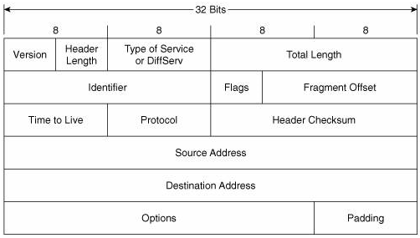
Packet Structure for IPv4
IPv4 Header. The IPv4 packet will contain both the header and the payload.
Reference
https://advancedinternettechnologies.wordpress.com/ipv4-header/

Slide 6
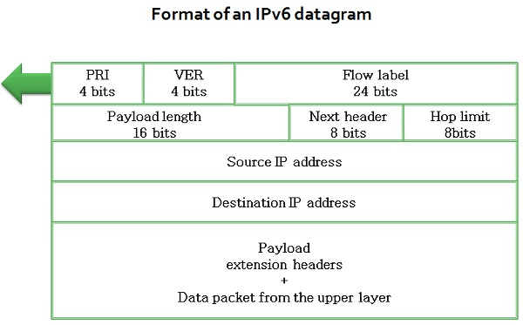
Packet Structure for IPv6
Reference
https://techdifferences.com/difference-between-ipv4-and-ipv6.html

Slide 7
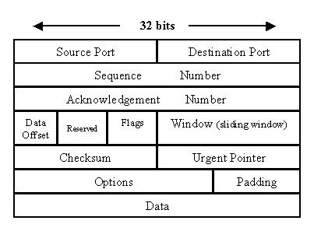
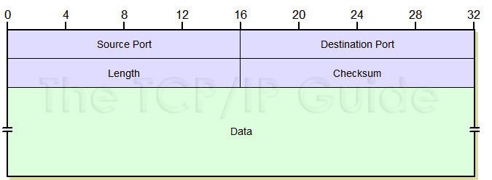
Unix Socket Packet Structure
These sockets can be used for IPC. Supports both SOCK_STREAM and SOCK_DGRAM.
If SOCK_STREAM is used packet structure would be the same as TCP. If SOCK_DGRAM is used packet structure would be the same as UDP.
SOCK_STREAM
SOCK_DGRAM
Reference
https://www.techrepublic.com/article/exploring-the-anatomy-of-a-data-packet/
Reference
http://www.tcpipguide.com/free/t_UDPMessageFormat.htm

Slide 8
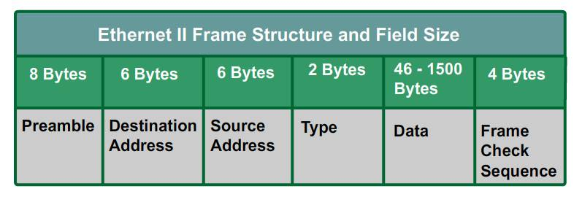
Datalink Socket Packet Structure
Such a socket is used to send Ethernet frames. It is a type of a RAW_SOCKET.
Reference
http://fschub.com/ethernet-frame-fields-structure/

Slide 9
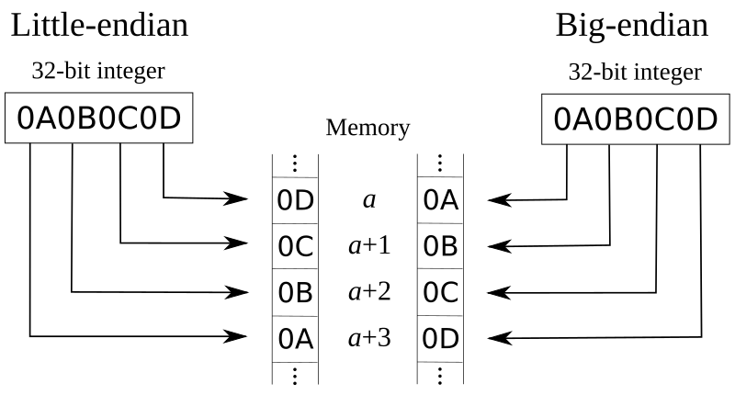
Little Endian vs Big Endian
The only difference between big endian and little endian is the order of bytes while storing them.
Network Byte Order is meaning the order of transmission for bits and bytes over the wire in network protocols.
Big Endian or Little Endian is converted to the Network Byte order before transmission with the help of byte swap macros.
Reference
https://en.wikipedia.org/wiki/File:Big-little_endian.png
Big Endian byte order has been chosen to be the network byte order. So Big Endian doesn’t need conversion to network byte order but little endian does need byte swapping to convert to network byte order.

Slide 10
IPv4 to 32 bit Network Byte order conversion
Multiple C functions are available to convert a dotted decimal IPv4 address to the network byte ordered decimal value.
inet_aton :
struct in_addr addr; inet_aton("10.0.0.1", &addr); // store IP in addr
inet_addr : A deprecated function now. Unable to handle the IP address 255.255.255.255 as it returns INADDR_NONE which is 32 bits 1 when an error is encountered.
struct in_addr addr; addr.s_addr = inet_addr("10.0.0.1"); // store IP in addr
inet_pton : Used to convert both IPv4 and IPv6 to network byte ordered decimal format. If the first argument is AF_INET then an IPv4 address is converted and if the first argument is AF_INET6 then an IPv6 address is converted.
unsigned char buf[sizeof(struct in6_addr)];
int s = inet_pton(AF_INET, “10.0.0.1”, buf);

Slide 11
Functions to read and write from a Socket stream
There are designated C functions to read and write from a socket stream.
Assuming Berkeley Sockets being used.
WRITING
ssize_t write(int fs, const void *buf, ssize_t N);
fs is the socket descriptor
buf is the pointer to the buffer holding data to be written
N is the size of the data to be written
READING
ssize_t read(int socket, void *buf, ssize_t N);
fs is the socket descriptor
buf is the pointer to the buffer that receives the data.
N is the length in bytes of the buffer pointed to by the buf parameter.

Slide 12
Example of read and write
/* Write to socket * socketfd is the socket descriptor * buffer is the pointer to the data to be written * strlen(buffer) is the length of the data to be written */ n = write(socketfd,buffer,strlen(buffer)); if(n < 0) error("Error writing to socket!"); bzero(buffer,256); /* Read from socket buffer * socketfd is the socket descriptor * buffer is the pointer to the socket buffer where all socket data is present * 255 is the socket buffer size */ n = read(socketfd,buffer,255); if(n < 0) error("Error reading from socket!");

